Slide 1

Homework #13 Feedback
Nice work on the transformations.
What patterns did you notice in the feasible region, with respect to convergence?
Who tried different Q-values? L-values? $α$-values?

Slide 2
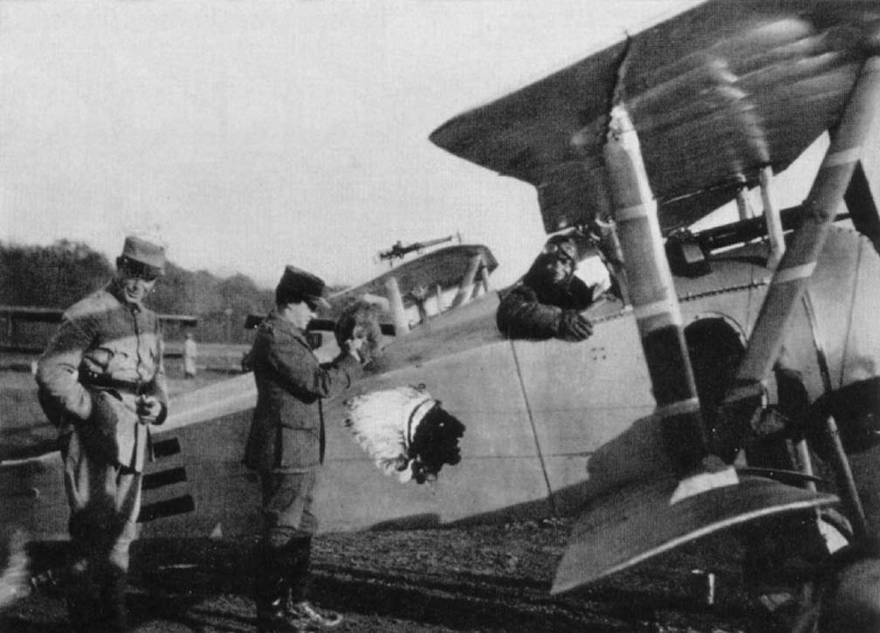
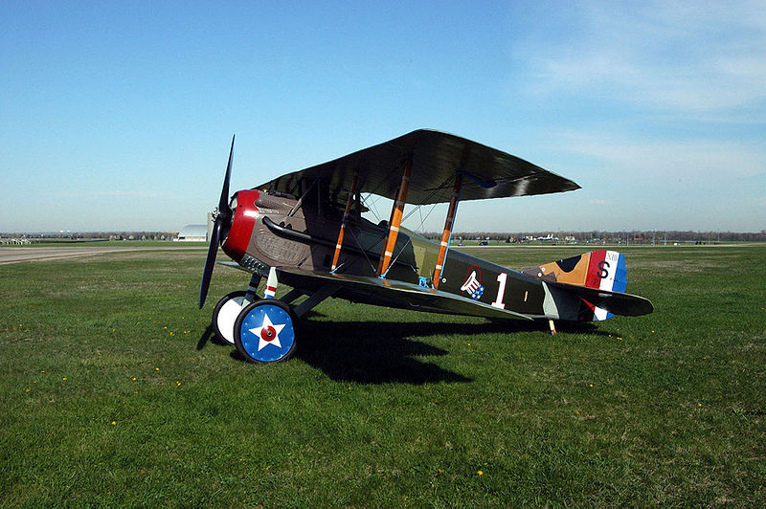
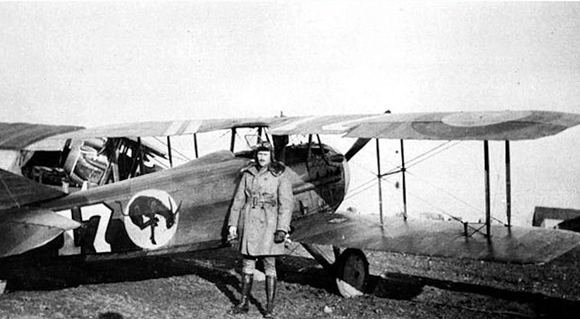
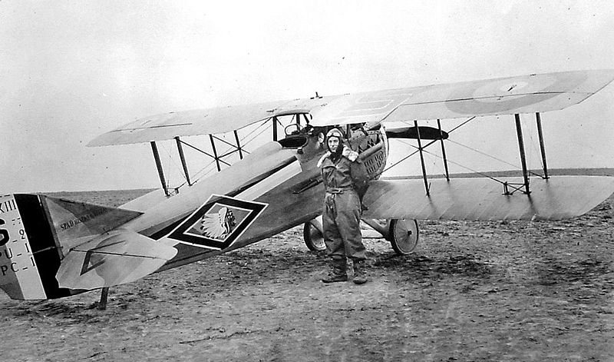
What’s special about these aircrafts’ squadrons?
Nieuport
SPAD XIII
SPAD XIII
SPAD XIII
Notes:
93rd Aero 94th Aero
Lafayette Escadrille 95th Aero

Slide 3


Karmarkar’s w/Different Q-values (Iterates after initialization)
$$Q=11$$
$$Q=100$$

Slide 4
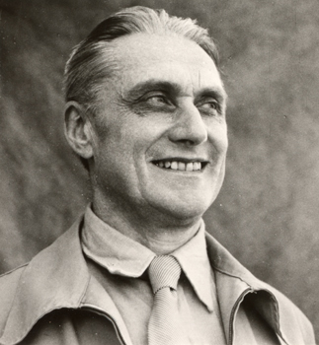
OPER 610 Lesson 18 Interior Point Methods 3: Primal & Primal-Dual Path Following Methods
1895 – 1973
Dr Brian J. Lunday
Office: Rm 201E, Bldg 641
Notes:
Frisch was one of the founders of economics as a modern science. He made a number of significant advances in the field of economics and coined a number of new words including econometrics and macroeconomics. His 1926 paper on consumer theory helped set up Neo-Walrasian research. He formalized production theory (1965). In econometrics he worked on time series (1927) and linear regression analysis (1934). With Frederick Waugh, he introduced the celebrated Frisch–Waugh theorem (Econometrica 1933) (sometimes referred to as the Frisch–Waugh–Lovell theorem). In oligopoly theory he developed the conjectural variation approach. His 1933 work on impulse-propagation business cycles became one of the principles of modern New Classical business cycle theory. He also helped introduce econometric modeling to government economic planning and accounting. He was one of the founders of the Econometric Society and editor of Econometrica for over twenty years. The Frisch Medal, so named in his honor, is given every two years for the best paper published in the aforementioned Econometrica in the previous five years.
Frisch's most important hobby was bee-keeping, for which Frisch performed genetic studies.

Slide 5
Major Developments in Linear Optimization
1947 Simplex Method (Dantzig)
1955 Logarithmic Barrier Method (Frisch)
1960 Method(s) of Feasible Directions (Zoutendijk)
1967 Affine Scaling Method (Dikin)
1967 *Center Method (Huard)
1968 *Barrier Methods (Fiacco, McCormick)
1972 Exponential example (Klee and Minty)
1979 Ellipsoid Method (Khachian)
1984 Projective Method (Karmarkar)
1989 Primal-dual Path Following (Kojima et al., Meggido)
1990 Predictor-corrector Algorithms (Mehrotra)
* Not covered in OPER 610

Slide 6
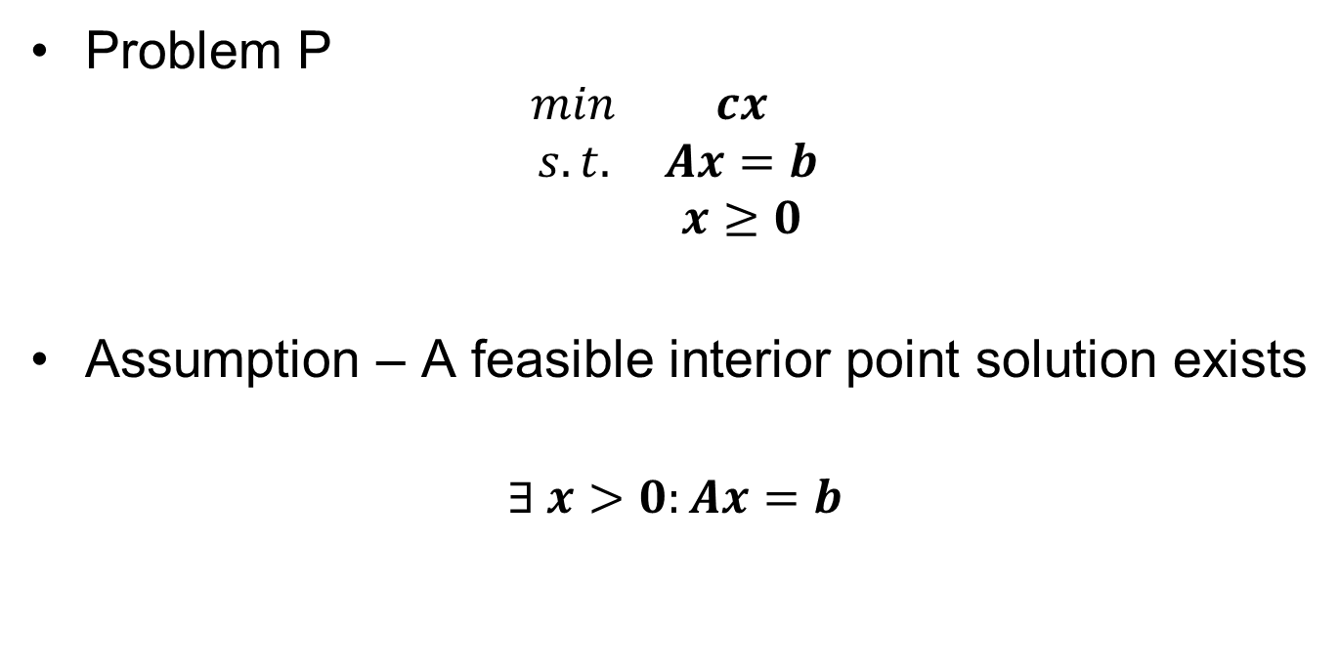
Basic Problem & Assumptions
Problem P
$$\begin{matrix}min & cx \\ s.t. & Ax=b \\ & x≥0\end{matrix}$$
Assumption – A feasible interior point solution exists
$$∃ x>0:Ax=b$$

Slide 7

Solve a Related Barrier Problem
Problem P
$$\begin{matrix}min & cx \\ s.t. & Ax=b \\ & x≥0\end{matrix}$$
Problem BP – for a given $μ>0$
$$\begin{matrix}min & cx−μ\sum_{j=1}^{n}{\ln{x_{j}}} \\ s.t. & Ax=b\end{matrix}$$

Slide 8


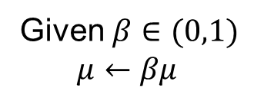
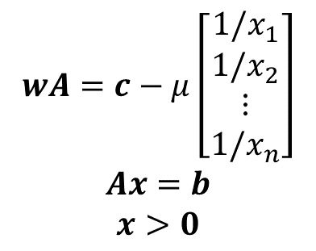
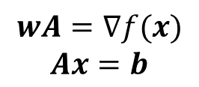
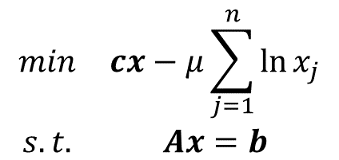
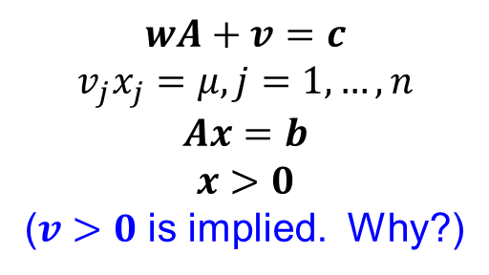
KKT Optimality & Feasibility Conditions for Problem BP
$$\begin{matrix}min & cx−μ\sum_{j=1}^{n}{\ln{x_{j}}} \\ s.t. & Ax=b\end{matrix}$$
$$wA=∇f(x)$$
$$Ax=b$$
As $μ→0^{+}$, $x^{∗}$ approaches the optimal solution to Problem P
$$wA=c−μ\left[\begin{aligned}1/x_{1} \\ 1/x_{2} \\ ⋮ \\ 1/x_{n}\end{aligned}\right]$$
$$Ax=b$$
$$x>0$$
Given $β∈(0,1)$
$$μ←βμ$$
$${\left(x,w,v\right)}^{∗}$$
as optimal solution to Problem BP
$$wA+v=c$$
$$v_{j}x_{j}=μ, j=1,…,n$$
$$Ax=b$$
$$x>0$$
($v>0$ is implied. Why?)

Slide 9
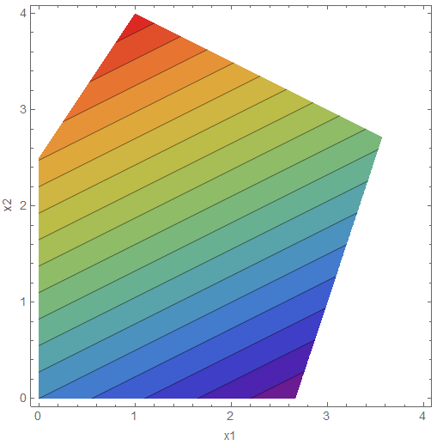
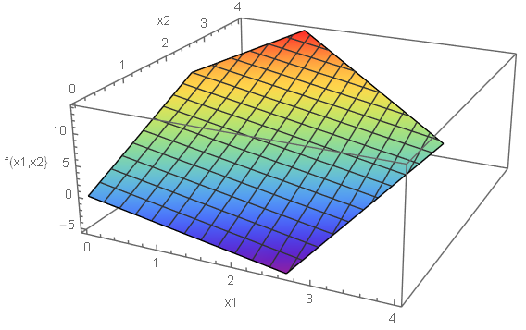

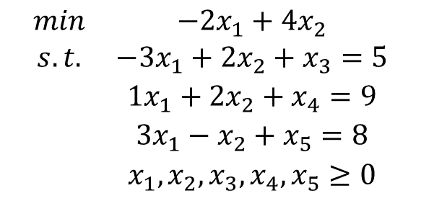
Example Problem P
$$\begin{matrix}min & −2x_{1}+4x_{2} \\ s.t. & −3x_{1}+2x_{2}+x_{3}=5 \\ & 1x_{1}+2x_{2}+x_{4}=9 \\ & 3x_{1}−x_{2}+x_{5}=8 \\ & x_{1},x_{2},x_{3},x_{4},x_{5}≥0\end{matrix}$$
$$x^{∗}=\left(2.6\overline{6},0,1\overline{3},6.3\overline{3},0\right)$$

Slide 10
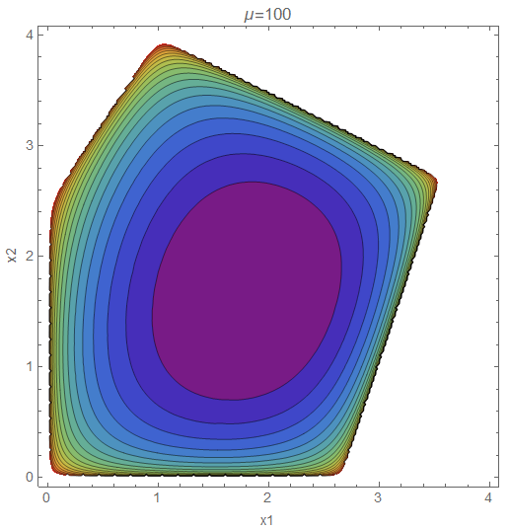
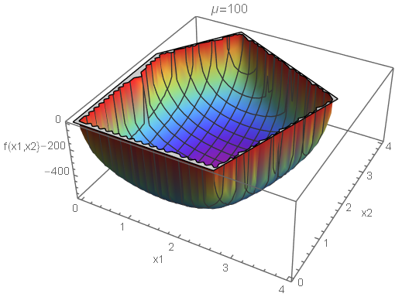

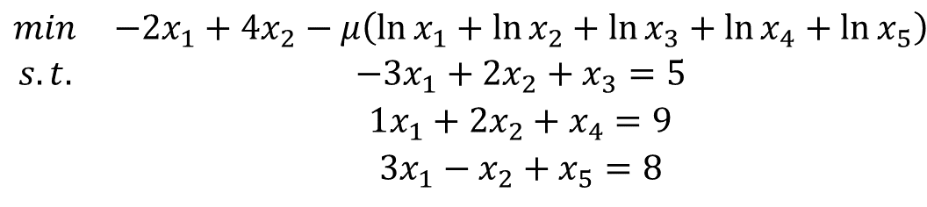

Example Problem BP ($μ=100$)
$$\begin{matrix}min & −2x_{1}+4x_{2}−μ\left(\ln{x_{1}}+\ln{x_{2}}+\ln{x_{3}}+\ln{x_{4}}+\ln{x_{5}}\right) \\ s.t. & −3x_{1}+2x_{2}+x_{3}=5 \\ & 1x_{1}+2x_{2}+x_{4}=9 \\ & 3x_{1}−x_{2}+x_{5}=8\end{matrix}$$
$$x^{∗}=\left(1.84, 1.67, 7.18, 3.83, 4.16\right)$$

Slide 11
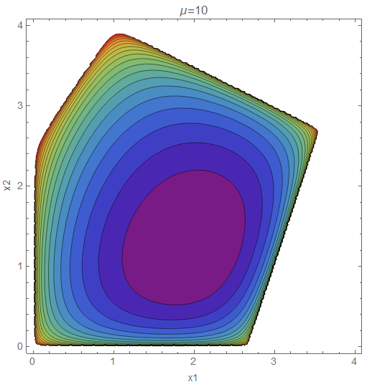
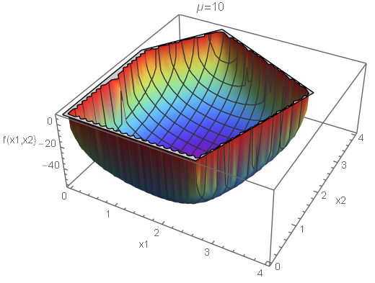


Example Problem BP ($μ=10$)
$$\begin{matrix}min & −2x_{1}+4x_{2}−μ\left(\ln{x_{1}}+\ln{x_{2}}+\ln{x_{3}}+\ln{x_{4}}+\ln{x_{5}}\right) \\ s.t. & −3x_{1}+2x_{2}+x_{3}=5 \\ & 1x_{1}+2x_{2}+x_{4}=9 \\ & 3x_{1}−x_{2}+x_{5}=8\end{matrix}$$
$$x^{∗}=\left(1.92, 1.26, 8.27, 4.55, 3.48\right)$$

Slide 12
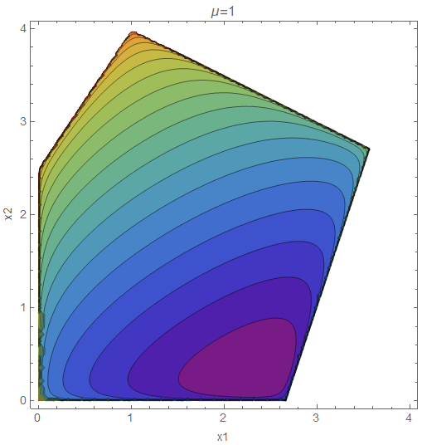
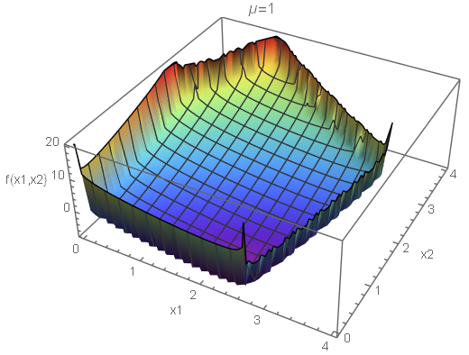


Example Problem BP ($μ=1$)
$$\begin{matrix}min & −2x_{1}+4x_{2}−μ\left(\ln{x_{1}}+\ln{x_{2}}+\ln{x_{3}}+\ln{x_{4}}+\ln{x_{5}}\right) \\ s.t. & −3x_{1}+2x_{2}+x_{3}=5 \\ & 1x_{1}+2x_{2}+x_{4}=9 \\ & 3x_{1}−x_{2}+x_{5}=8\end{matrix}$$
$$x^{∗}=\left(2.36, 0.27, 11.54, 6.09, 1.19\right)$$

Slide 13
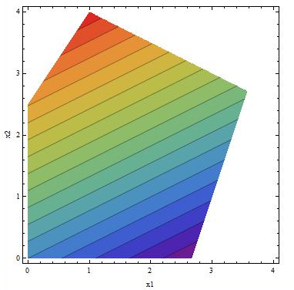
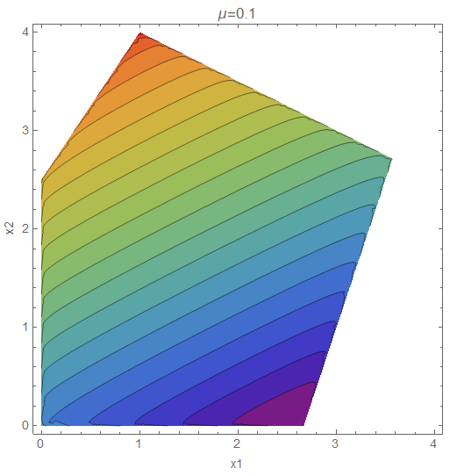
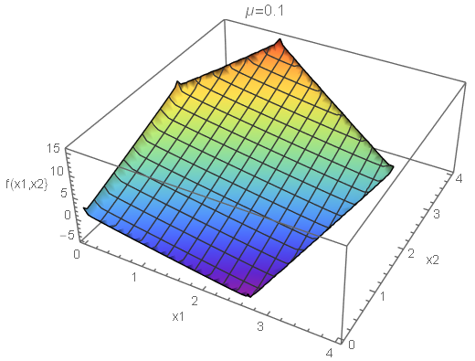


Example Problem BP ($μ=0.1$)
$$\begin{matrix}min & −2x_{1}+4x_{2}−μ\left(\ln{x_{1}}+\ln{x_{2}}+\ln{x_{3}}+\ln{x_{4}}+\ln{x_{5}}\right) \\ s.t. & −3x_{1}+2x_{2}+x_{3}=5 \\ & 1x_{1}+2x_{2}+x_{4}=9 \\ & 3x_{1}−x_{2}+x_{5}=8\end{matrix}$$
$$x^{∗}=\left(2.63, 0.03, 12.82, 6.31, 0.15\right)$$

Slide 14


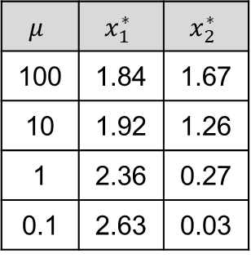
The Central Path
$$\begin{matrix}min & −2x_{1}+4x_{2} \\ s.t. & −3x_{1}+2x_{2}+x_{3}=5 \\ & 1x_{1}+2x_{2}+x_{4}=9 \\ & 3x_{1}−x_{2}+x_{5}=8 \\ & x_{1},x_{2},x_{3},x_{4},x_{5}≥0\end{matrix}$$
$$μ$$ | $$x_{1}^{∗}$$ | $$x_{2}^{∗}$$
100 | 1.84 | 1.67
10 | 1.92 | 1.26
1 | 2.36 | 0.27
0.1 | 2.63 | 0.03
$$x^{∗}=\left(2.6\overline{6},0,1\overline{3},6.3\overline{3},0\right)$$

Slide 15
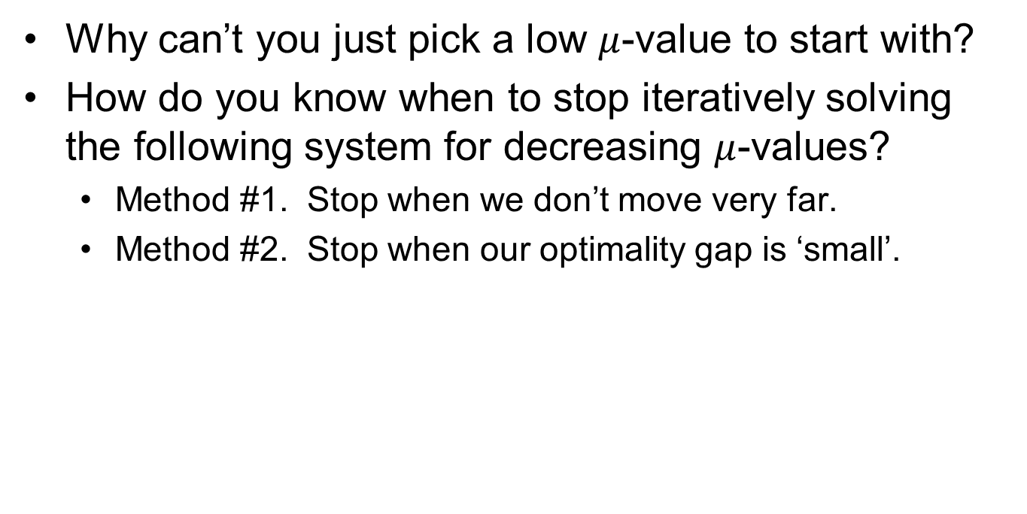

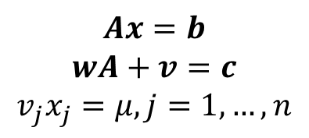



Discussion Questions
Why can’t you just pick a low $μ$-value to start with?
How do you know when to stop iteratively solving the following system for decreasing $μ$-values?
Method #1. Stop when we don’t move very far.
Method #2. Stop when our optimality gap is ‘small’.
$$Ax=b$$
$$wA+v=c$$
$$v_{j}x_{j}=μ, j=1,…,n$$
$$wAx=wb$$
$$wAx+vx=cx$$
$$cx−wb=vx$$
$$vx=nμ$$

Slide 16
Primal-Dual Path-Following Method

Slide 17
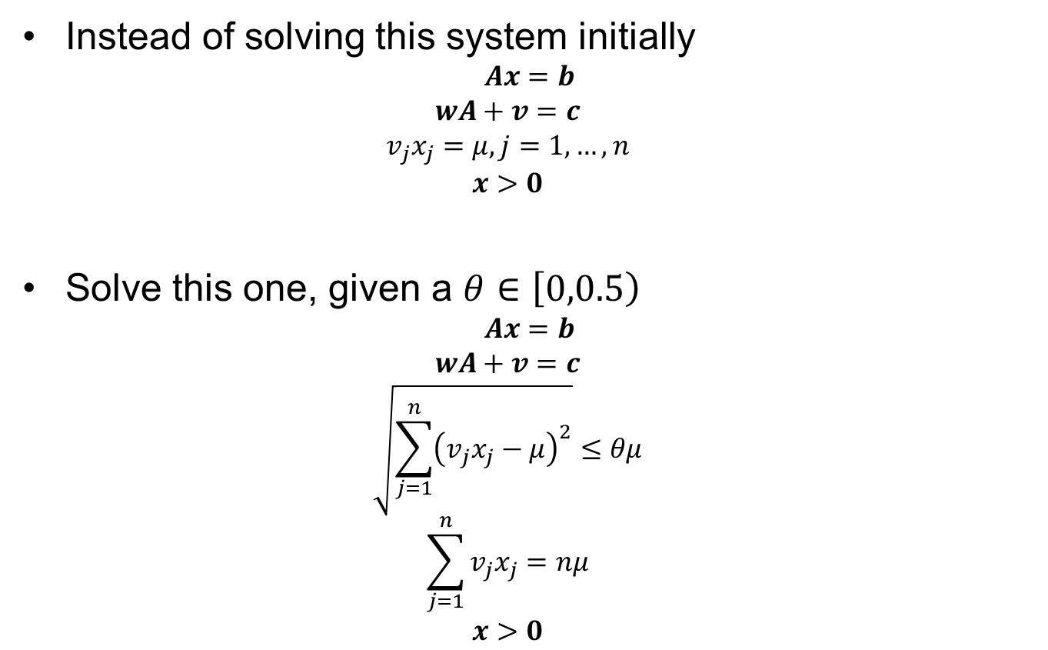
Speeding Up the Algorithm (1 of 2) Start “Close enough” to the Central Path
Instead of solving this system initially
$$Ax=b$$
$$wA+v=c$$
$$v_{j}x_{j}=μ, j=1,…,n$$
$$x>0$$
Solve this one, given a $θ∈\left[0,0.5\right)$
$$Ax=b$$
$$wA+v=c$$
$$\sqrt{\sum_{j=1}^{n}{{\left(v_{j}x_{j}−μ\right)}^{2}}}≤θμ$$
$$\sum_{j=1}^{n}{v_{j}x_{j}}=nμ$$
$$x>0$$
Solving this system would find a point on the Central Path
Solving this system will find a point “close” to the Central Path
What are these doing?

Slide 18
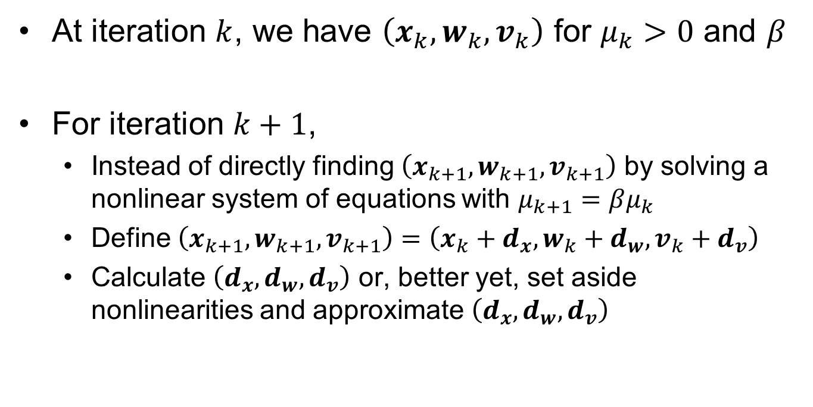
Speeding Up the Algorithm (2 of 2) “Move from Point to Point along the CP”
At iteration $k$, we have $\left(x_{k}, w_{k}, v_{k}\right)$ for $μ_{k}>0$ and $β$
For iteration $k+1$,
Instead of directly finding $\left(x_{k+1}, w_{k+1}, v_{k+1}\right)$ by solving a nonlinear system of equations with $μ_{k+1}=βμ_{k}$
Define $\left(x_{k+1}, w_{k+1}, v_{k+1}\right)=\left(x_{k}+d_{x}, w_{k}+d_{w}, v_{k}+d_{v}\right)$
Calculate $\left(d_{x}, d_{w}, d_{v}\right)$ or, better yet, set aside nonlinearities and approximate $\left(d_{x}, d_{w}, d_{v}\right)$

Slide 19
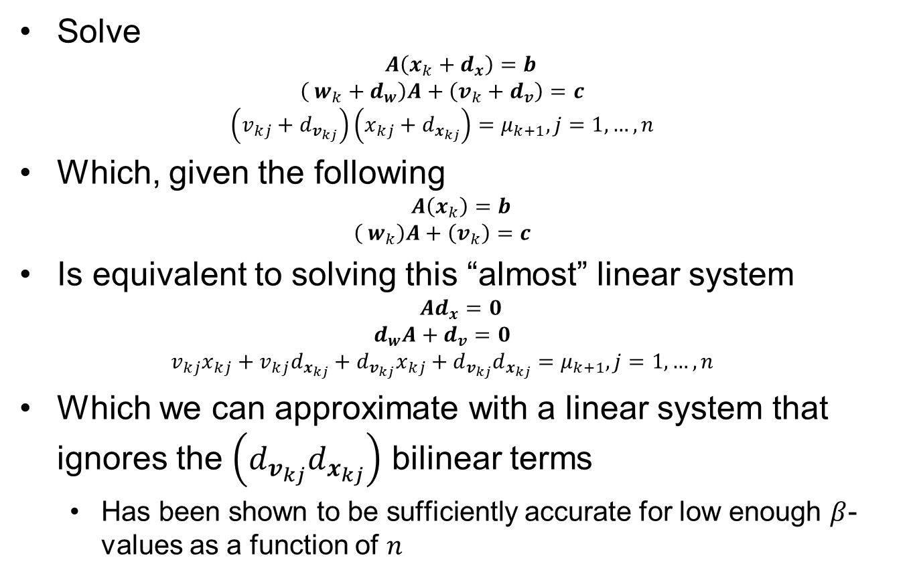
Primal-Dual Path-Following Method
Solve
$$A\left(x_{k}+d_{x}\right)=b$$
$$\left( w_{k}+d_{w}\right)A+\left(v_{k}+d_{v}\right)=c$$
$$\left(v_{kj}+d_{v_{kj}}\right)\left(x_{kj}+d_{x_{kj}}\right)=μ_{k+1}, j=1,…,n$$
Which, given the following
$$A\left(x_{k}\right)=b$$
$$\left( w_{k}\right)A+\left(v_{k}\right)=c$$
Is equivalent to solving this “almost” linear system
$$Ad_{x}=0$$
$$d_{w}A+d_{v}=0$$
$$v_{kj}x_{kj}+v_{kj}d_{x_{kj}}+d_{v_{kj}}x_{kj}+d_{v_{kj}}d_{x_{kj}}=μ_{k+1}, j=1,…,n$$
Which we can approximate with a linear system that ignores the $\left(d_{v_{kj}}d_{x_{kj}}\right)$ bilinear terms
Has been shown to be sufficiently accurate for low enough $β$-values as a function of $n$
Newton’s Method!

Slide 20
Primal Path-Following Method
Bertsimas, D., & Tsitsiklis, J. N. (1997). Introduction to linear optimization. Belmont, MA: Athena Scientific.

Slide 21
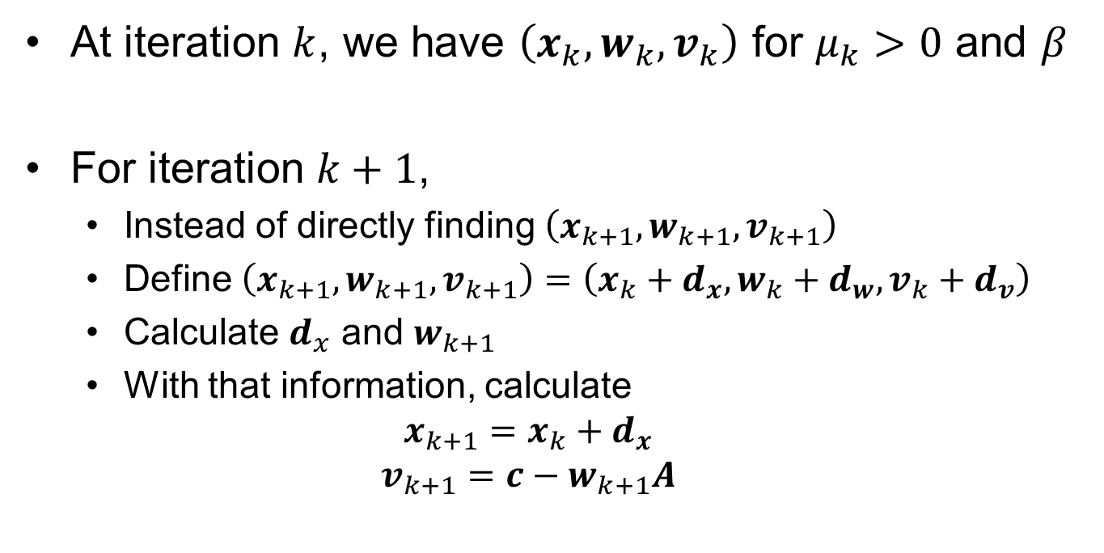
Primal Path-Following Method (1 of 3)
At iteration $k$, we have $\left(x_{k}, w_{k}, v_{k}\right)$ for $μ_{k}>0$ and $β$
For iteration $k+1$,
Instead of directly finding $\left(x_{k+1}, w_{k+1}, v_{k+1}\right)$
Define $\left(x_{k+1}, w_{k+1}, v_{k+1}\right)=\left(x_{k}+d_{x}, w_{k}+d_{w}, v_{k}+d_{v}\right)$
Calculate $d_{x}$ and $w_{k+1}$
With that information, calculate
$$x_{k+1}=x_{k}+d_{x}$$
$$v_{k+1}=c−w_{k+1}A$$

Slide 22
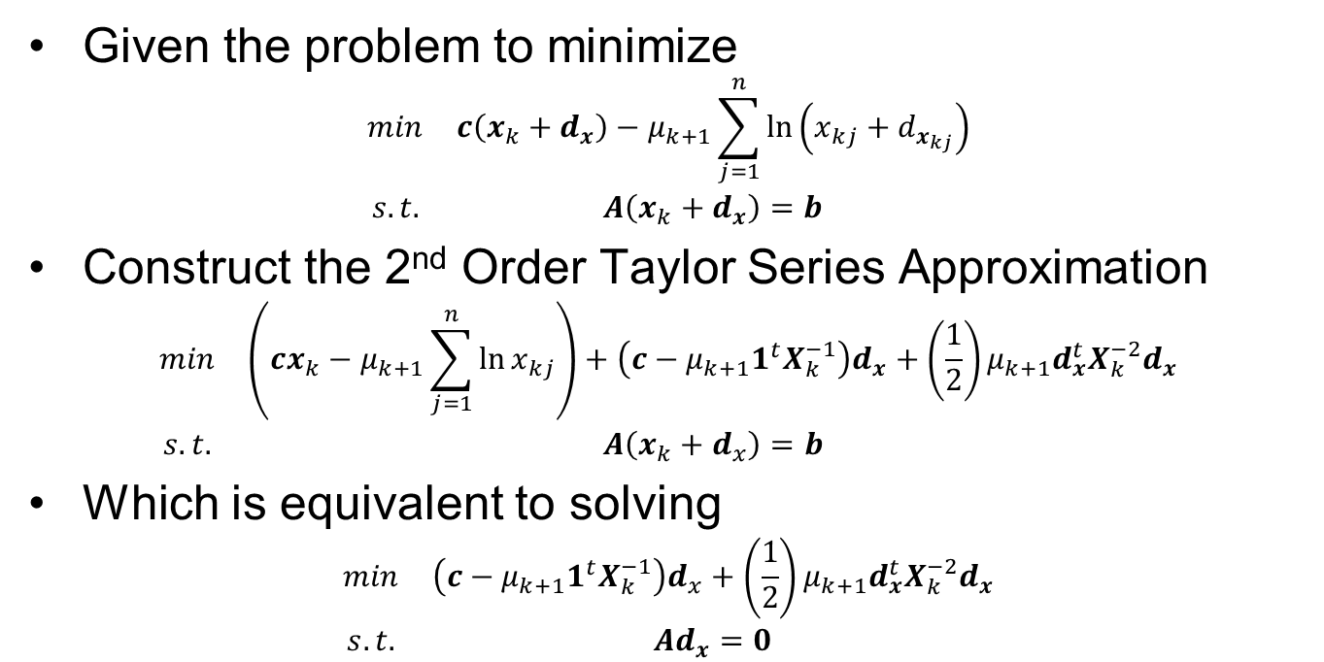
Primal Path-Following Method (2 of 3)
Given the problem to minimize
$$\begin{matrix}min & c\left(x_{k}+d_{x}\right)−μ_{k+1}\sum_{j=1}^{n}{\ln\left(x_{kj}+d_{x_{kj}}\right)} \\ s.t. & A\left(x_{k}+d_{x}\right)=b\end{matrix}$$
Construct the 2nd Order Taylor Series Approximation
$$\begin{matrix}min & \left(cx_{k}−μ_{k+1}\sum_{j=1}^{n}{\ln{x_{kj}}}\right)+\left(c−μ_{k+1}1^{t}X_{k}^{−1}\right)d_{x}+\left(\frac{1}{2}\right)μ_{k+1}d_{x}^{t}X_{k}^{−2}d_{x} \\ s.t. & A\left(x_{k}+d_{x}\right)=b\end{matrix}$$
Which is equivalent to solving
$$\begin{matrix}min & \left(c−μ_{k+1}1^{t}X_{k}^{−1}\right)d_{x}+\left(\frac{1}{2}\right)μ_{k+1}d_{x}^{t}X_{k}^{−2}d_{x} \\ s.t. & Ad_{x}=0\end{matrix}$$

Slide 23
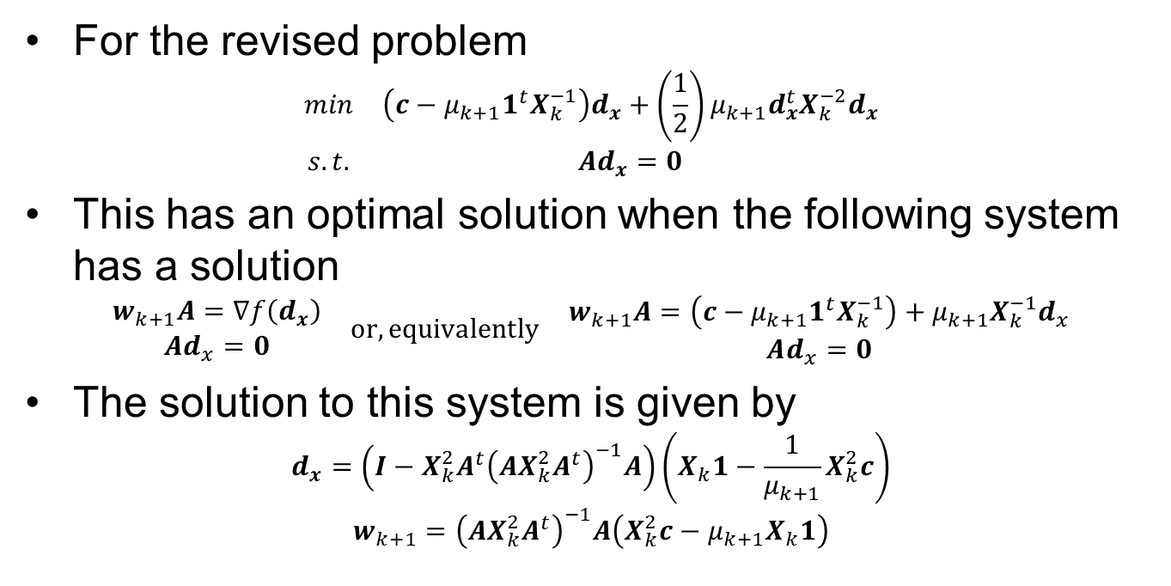
Primal Path-Following Method (3 of 3)
For the revised problem
$$\begin{matrix}min & \left(c−μ_{k+1}1^{t}X_{k}^{−1}\right)d_{x}+\left(\frac{1}{2}\right)μ_{k+1}d_{x}^{t}X_{k}^{−2}d_{x} \\ s.t. & Ad_{x}=0\end{matrix}$$
This has an optimal solution when the following system has a solution
$$\begin{matrix}\begin{aligned}w_{k+1}A=∇f\left(d_{x}\right) \\ Ad_{x}=0\end{aligned} & or, equivalently & \begin{aligned}w_{k+1}A=\left(c−μ_{k+1}1^{t}X_{k}^{−1}\right)+μ_{k+1}X_{k}^{−1}d_{x} \\ Ad_{x}=0\end{aligned}\end{matrix}$$
The solution to this system is given by
$$d_{x}=\left(I−X_{k}^{2}A^{t}{\left(AX_{k}^{2}A^{t}\right)}^{−1}A\right)\left(X_{k}1−\frac{1}{μ_{k+1}}X_{k}^{2}c\right)$$
$$w_{k+1}={\left(AX_{k}^{2}A^{t}\right)}^{−1}A\left(X_{k}^{2}c−μ_{k+1}X_{k}1\right)$$

Slide 24
For Discussion
From a conceptual viewpoint, how do the PD and Primal Path Following Methods compare to the Affine Scaling Algorithm and Karmarkar’s Algorithm?

Slide 25
Questions & Discussion

Slide 26
For Next Class
Section 5.3 (Review)
Homework #15: Problem 8.44
Use the algorithm as described on pp. 429-430 in the text, not the variant described in Exercise 8.43.
Show the progress of iterates (as directed by the text)
Purify the resulting solution

